Slide 1



Women Into STEM

Slide 2
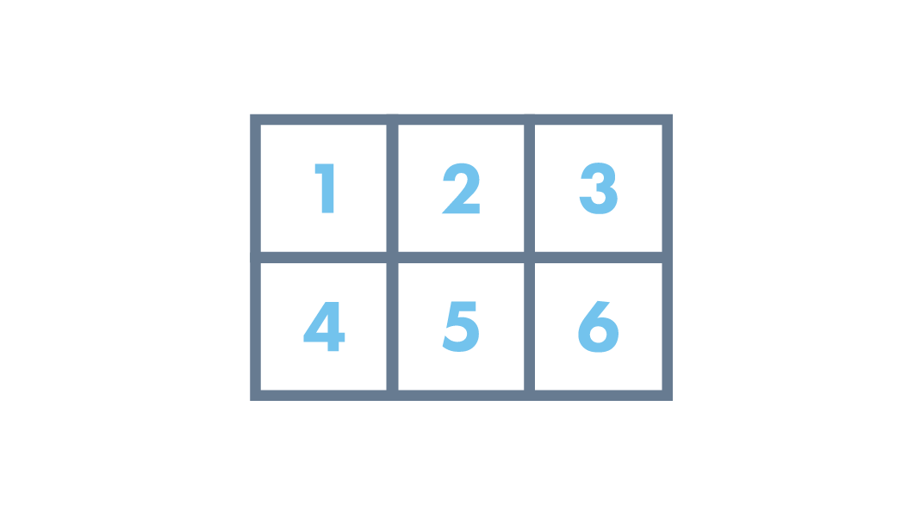
Today’s Topics
The Purpose of the Programme
What to Expect
Guest - Shreya Tripathi
What is Marketing?
Types of Marketing
Marketing Methods
Case Studies
Customer Channels
Digital Marketing

Slide 3
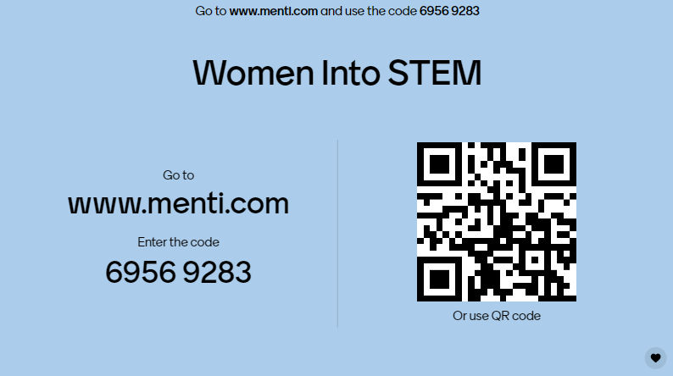

Slide 4
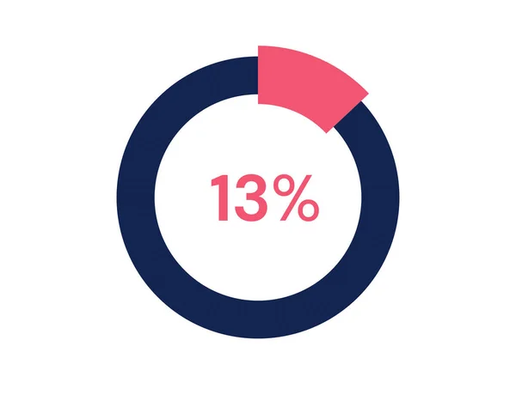
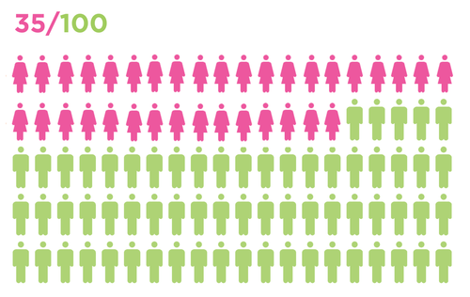
The Purpose
According the recent UCAS data, 35% of STEM students in further and higher education in the UK are women.
13% of the overall UK STEM workforce are women in STEM.

Slide 5
Key factors in gender STEM gaps:
Gender Stereotypes
Male-Dominated Culture
Fewer Role Models
Under representation
The Confidence Gap & Imposter Syndrome

Slide 6
What to Expect
We are challenging YOU to create a marketing campaign to encourage more young women – your peers – to get into STEM based careers.
STEP 1 – Attend the 4 workshops to support and guide you through the process
STEP 2 – In groups of up to 6, work together to create your marketing campaign.
STEP 3 – Final showcase where we can celebrate your hard work.

Slide 7
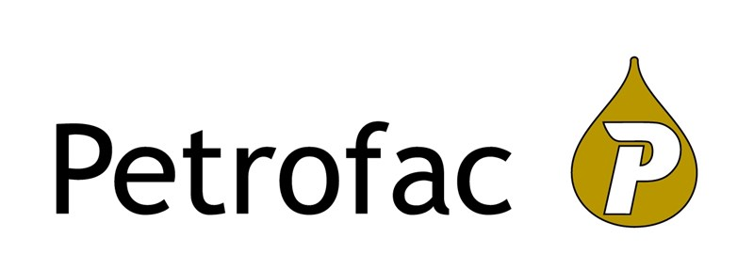
Shreya Tripathi

Slide 8
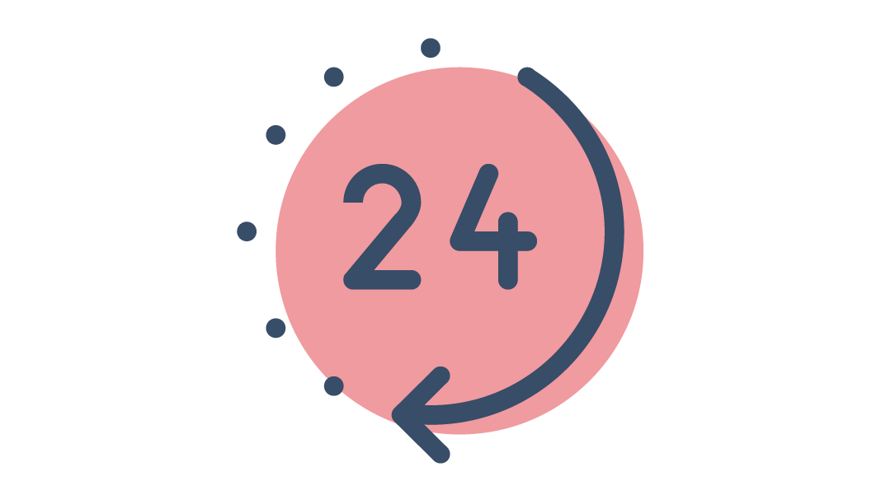
Marketing

Slide 9


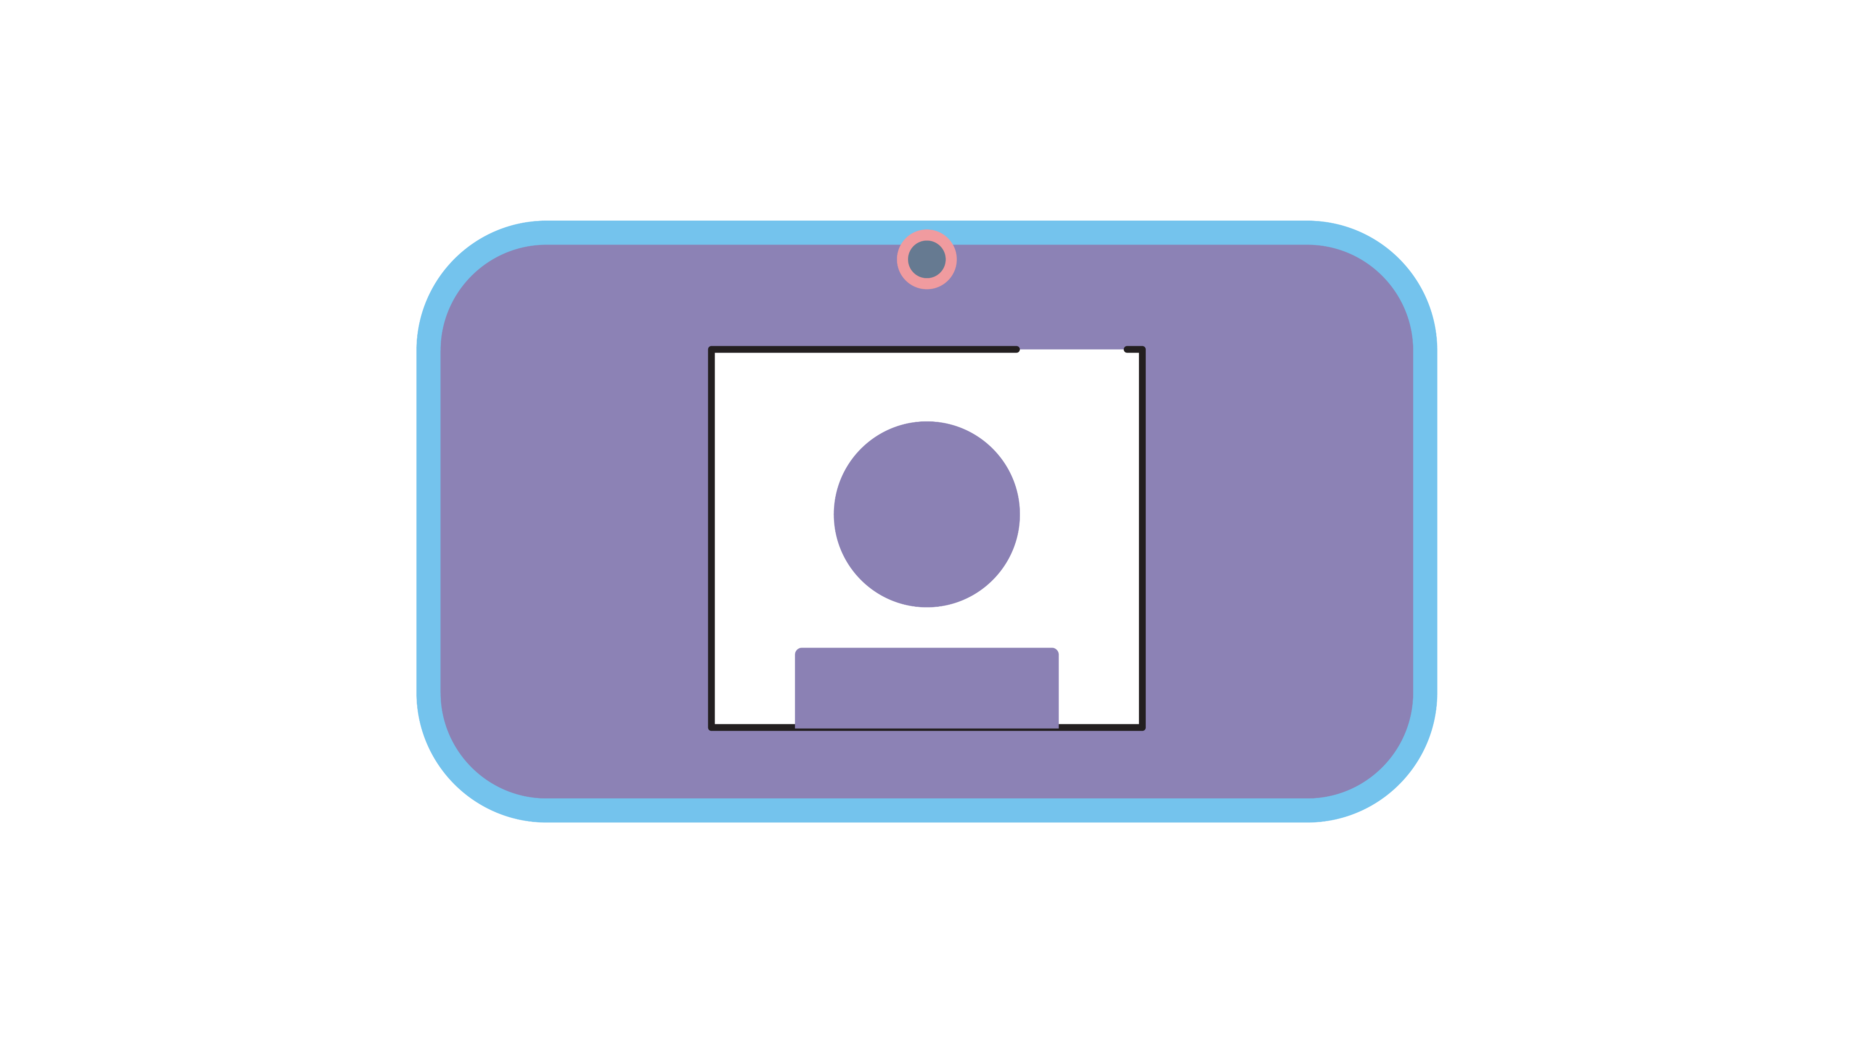

Teams Etiquette
Notes:
Introduction to functions of Zoom/Teams
Chat function
Raising hands
Unmute/mute

Slide 10


Today’s Session
 | We will take up to 55 minutes.
 | You will need a pen and paper and access to a search engine.

Slide 11

Learning Objectives
You will understand the fundamentals of Marketing.
You will be able to understand the difference between Traditional Marketing and Digital Marketing methods.
You will be able to understand what Channels you can use to reach your customer.

Slide 12

What is Marketing?
The process or activities which promote and sell business products or services.
It’s about how to build and grow your business and knowing your customer and understanding exactly where, how and when to engage with your customers.
All of the activities, platforms and tools we use in marketing come together to create a Marketing Strategy, usually documented in a Marketing Plan.
Notes:
KH Notes:
What is Marketing?
The process or activities which promote and sell business products or services.
It’s about how to build and grow your business and knowing your customer and understanding exactly where, how and when to engage with your customers.
**Interactive – unmute/chat - Why is marketing important & what does it do for business?**

Slide 13

Why do we need Marketing?
Growth
Sustainability
Profitability
Engages Customers
Establishes Presence
Competitive Advantage
Widens Reach

Slide 14
Discussion
What is the last advert you saw and enjoyed? Where do you see most adverts? When was the last time you bought something from an advert? What brands can you think of that are famous for their adverts? These are all types of Marketing.
1

Slide 15


Types of Marketing
Press Releases Brochures Billboards Ads Leaflets TV and radio | Email Telemarketing Direct Selling | Online adverts Social media
Notes:
Traditional
Methods used before the internet was born: Press releases, brochures, billboards ads, leaflets, TV and radio.
Direct Marketing
Examples of direct marketing include email marketing, telemarketing and direct selling.
Digital Marketing
Internet adverts and campaigns on social media.

Slide 16


Marketing Methods
Word of mouth: Passing information through communication, where often story telling is involved.
Transactional marketing: business strategy that focuses on single, "point of sale" transactions.
Diversity marketing: appeals to and includes diverse groups of consumers.
Emotional marketing: inflicting emotions to appeal to your customers.
Notes:
Paid advertising: Targeted to specific consumer/ business profiles.
Cause marketing: Cause marketing links the services and products of a company to a social cause or issue.
Relationship marketing: Focuses on customer retention & satisfaction.
Undercover marketing: Known as 'buzz' or stealth marketing, which focuses on hidden marketing techniques.
Word of mouth: Passing information through communication, where often story telling is involved.
Transactional marketing: business strategy that focuses on single, "point of sale" transactions.
Diversity marketing: appeals to and includes diverse groups of consumers.
Emotional marketing: inflicting emotions to appeal to your customers.

Slide 17


Marketing Methods
Paid advertising: Targeted to specific consumer/ business profiles.
Cause marketing: Cause marketing links the services and products of a company to a social cause or issue.
Relationship marketing: Focuses on customer retention & satisfaction.
Undercover marketing: Known as 'buzz' or stealth marketing, which focuses on hidden marketing techniques.
Notes:
Paid advertising: Targeted to specific consumer/ business profiles.
Cause marketing: Cause marketing links the services and products of a company to a social cause or issue.
Relationship marketing: Focuses on customer retention & satisfaction.
Undercover marketing: Known as 'buzz' or stealth marketing, which focuses on hidden marketing techniques.
Word of mouth: Passing information through communication, where often story telling is involved.
Transactional marketing: business strategy that focuses on single, "point of sale" transactions.
Diversity marketing: appeals to and includes diverse groups of consumers.
Emotional marketing: inflicting emotions to appeal to your customers.

Slide 18
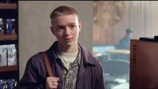
Notes:
Starbucks #whatsyourname campaign celebrates this signature act and the significance it can have for some transgender and gender diverse people as they use their new name in public. The advert, created in partnership with creative agency Iris, was inspired by real life experiences of people who were transitioning. discovered that they found Starbucks stores to be a safe space, where their new name was accepted, and they could be recognised as who they are.
What marketing method have they used?
Why was it effective?
What message does it give to their customers?

Slide 19

Case Studies
Starbucks
Every Name’s a Story #whatsyourname
“Starbucks welcomes you, whoever you are and whomever you want to be.”
Inflicts their values, brings their communities together and connects with their customers.
Notes:
Starbucks #whatsyourname campaign celebrates this signature act and the significance it can have for some transgender and gender diverse people as they use their new name in public. The advert, created in partnership with creative agency Iris, was inspired by real life experiences of people who were transitioning. discovered that they found Starbucks stores to be a safe space, where their new name was accepted, and they could be recognised as who they are.
What marketing method have they used?
Why was it effective?
What message does it give to their customers?

Slide 20
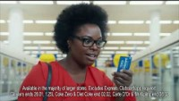

Slide 21
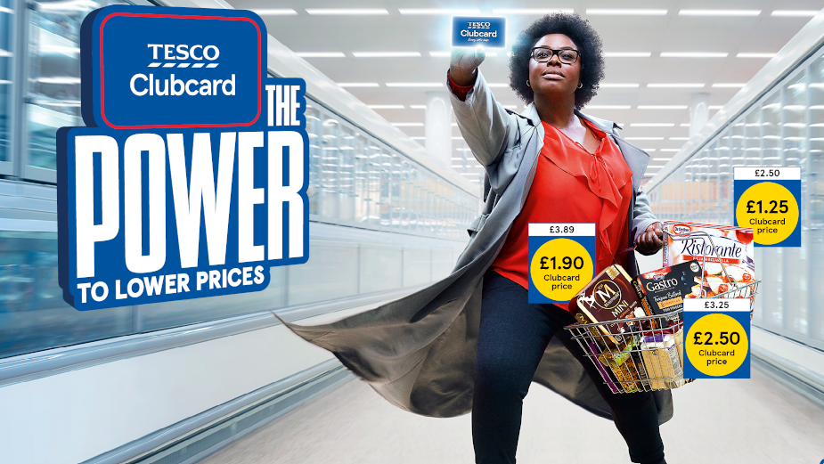
Case Studies
Tesco Clubcard:
“The Power to Lower Prices”
What does it do for customers?
What method of marketing does it use?
Notes:
Tesco Clubcard – The Power to Lower Prices

Slide 22
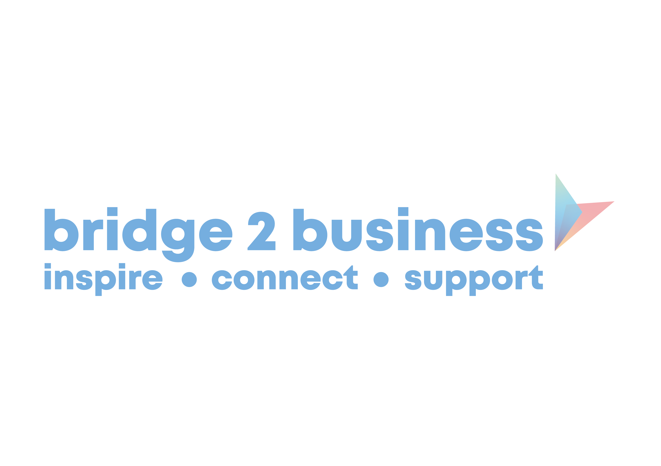



Slide 23

Case Studies
Always ‘Like A Girl’
What does the campaign do?​
​
How does it make you feel?

Slide 24

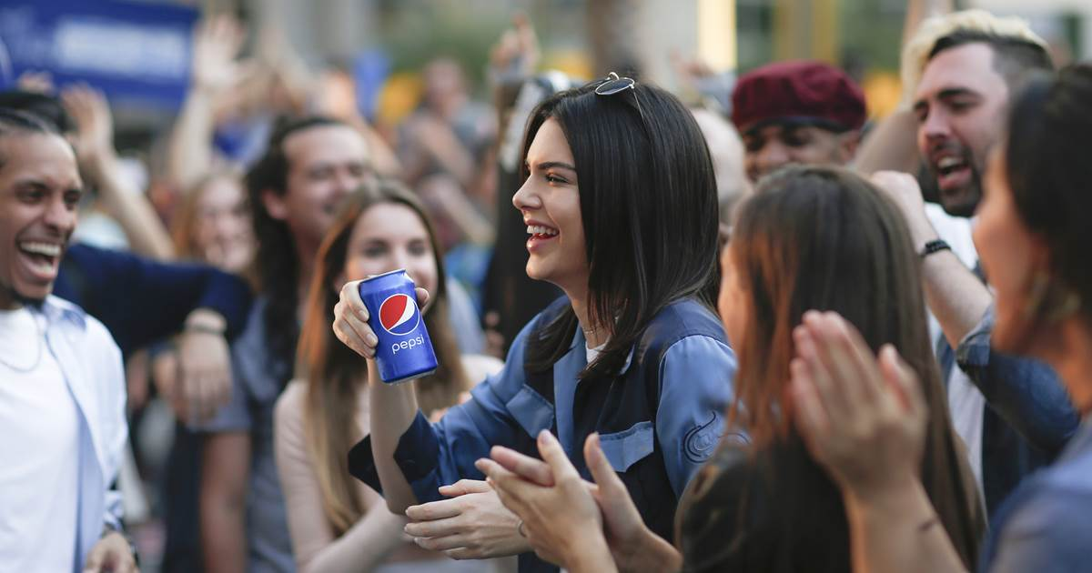
Marketing Fails
Starbucks
Pepsi

Slide 25


Slide 26



Social Media Platforms
Different platforms will be relevant for different customer groups.
Most popular platforms:
Facebook
Instagram
Twitter
YouTube
Pinterest
TikTok

Slide 27
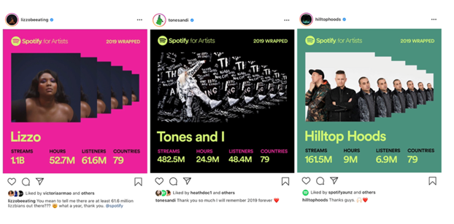
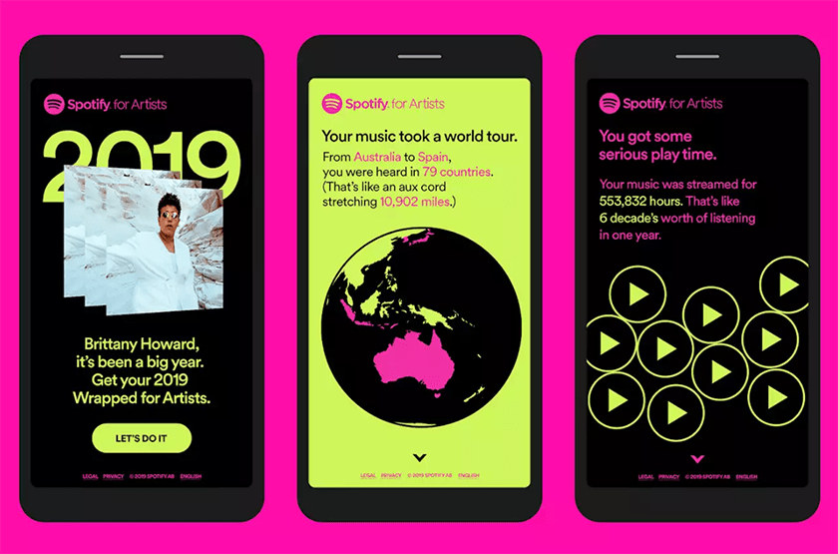
Case Study: Spotify Wrapped
Notes:
Spotify share a “year-end” type gathering of their most listened songs of the year.
In 2020, they heightened the campaign even more with a snapshot of data from the past 10 years.
Users were able to share perfectly collated images on their Instagram, Facebook and Twitter – and of course, Spotify!
Why do you think this was so successful?
Why it worked: Users love personalized data—even if some of us (ahem) would be grateful not to know how many times we listened to Adele while crying. That’s why you can’t resist a good Buzzfeed quiz or a particularly accurate horoscope.
By offering users fun and insightful data visualizations to share, Spotify essentially created a winning ad campaign and let their users do the work of promoting it. That kind of social proof is hard to beat. The Spotify Wrapped format is so recognizable, it even became a meme.
Tying your campaign to an annual event (like the end of the year) also builds anticipation among your fans, helping it to grow bigger every year.

Slide 28
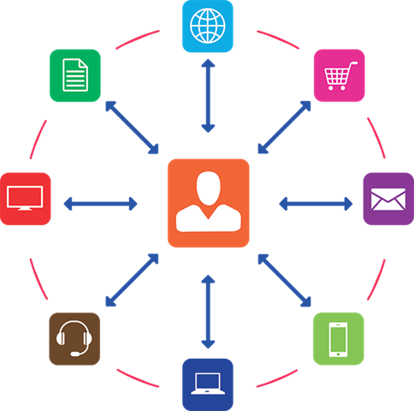

Slide 29

Round - Up
What is Marketing?
Types of Marketing
Marketing Methods
Customer Channels
Social Media

Slide 30


Slide 31




Get In Touch:
Morven McColl
Programme Executive – Bridge 2 Business
Morven.McColl@yes.org.uk
Morven McColl (@morven_mccoll) / Twitter
Morven McColl | LinkedIn
Notes:
Bridge 2 Business Student Support
Feeling inspired and want to have a chat with Bridge 2 Business? Why not get in touch and schedule a 1-2-1 with us!
In your 1-2-1 we’ll discuss your idea(s) or any of the initititaives you are interested in, and what support or funding could be best suited for you, as well as what other support is available to test your ideas, and get them off the ground. Some support from other external partners have age and industry restrictions – this is something we will discuss at your 1-2-1. We can help you develop your business ideas further through basic business planning to help you kick started!

Slide 32

Any Questions?

