Slide 1


Women Into STEM
Session 4 – Final Workshop

Slide 2
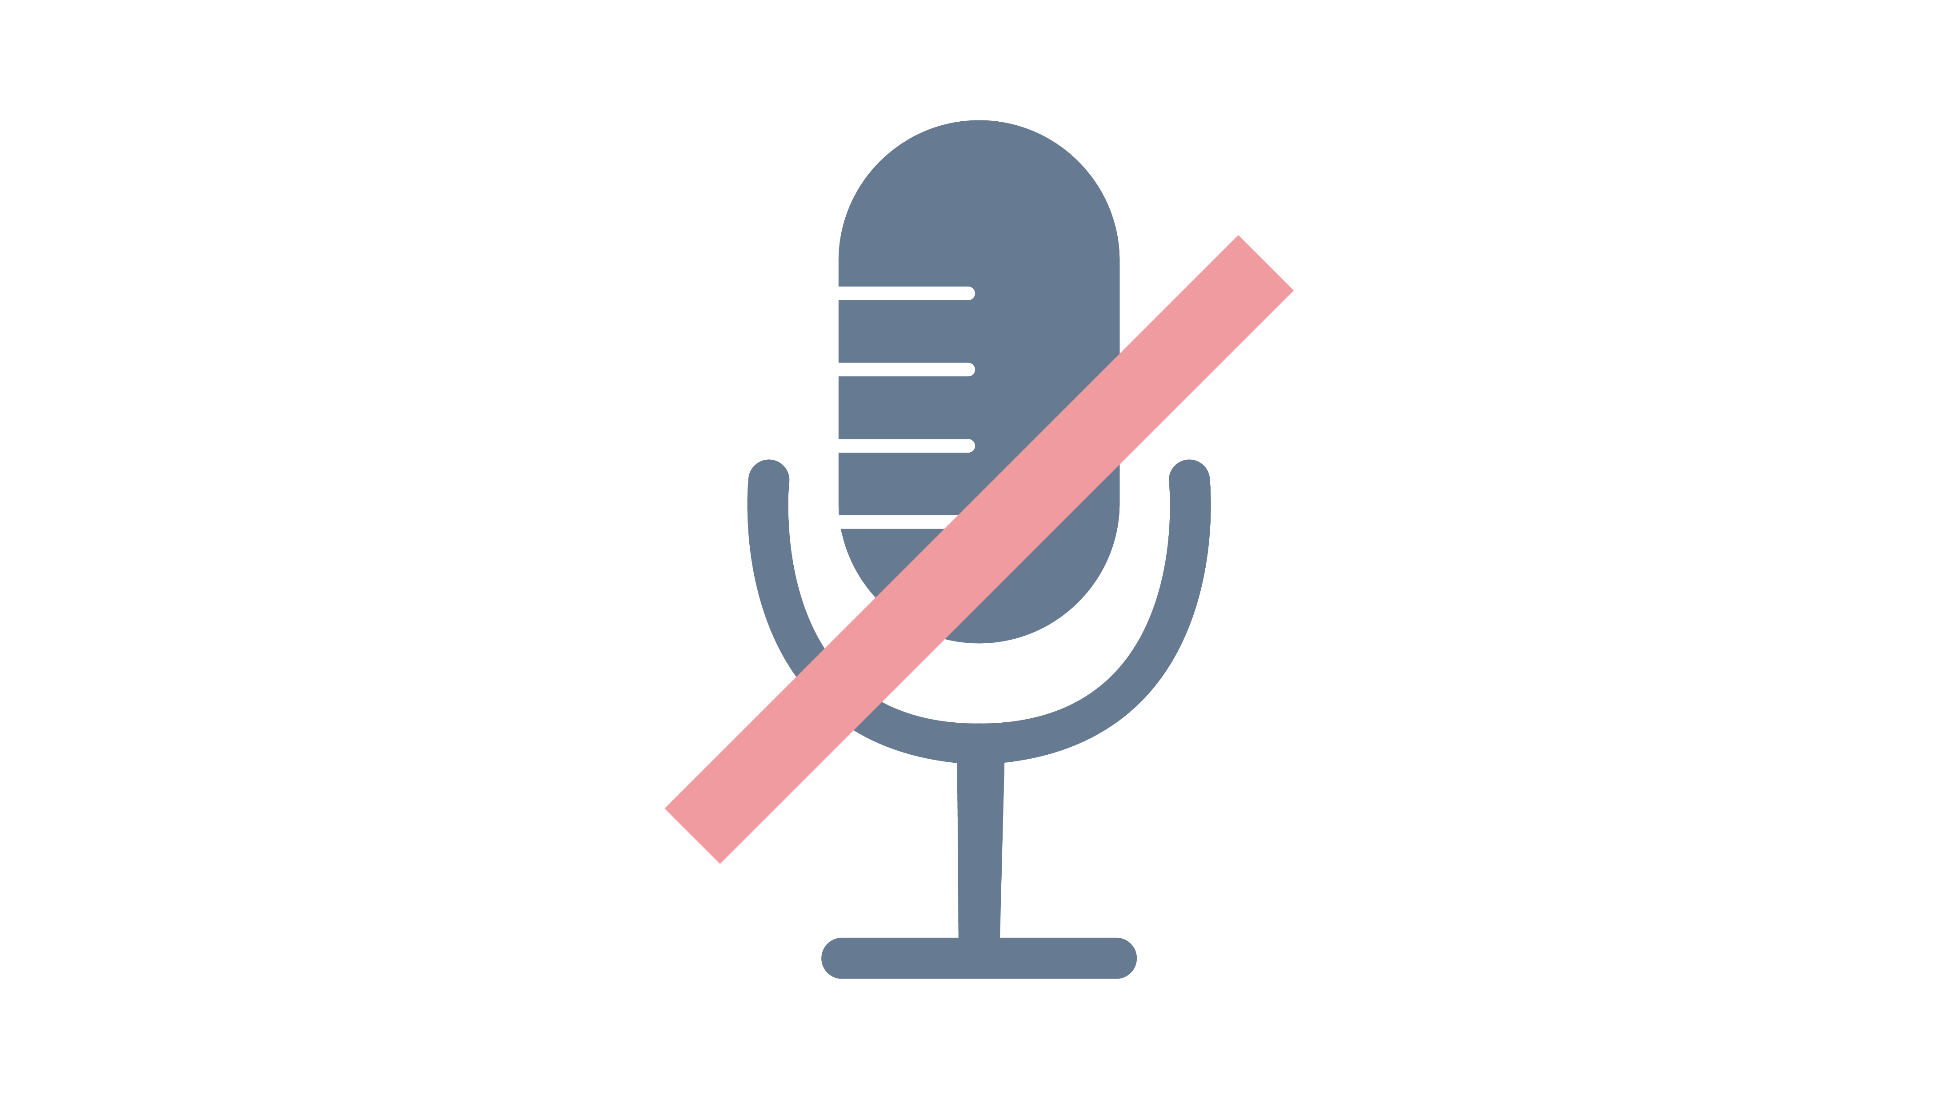



Teams Etiquette
Notes:
Introduction to functions of Zoom/Teams
Chat function
Raising hands
Unmute/mute

Slide 3


Today’s Session
 | We will take up to 55 minutes.
 | You will need a pen and paper.

Slide 4
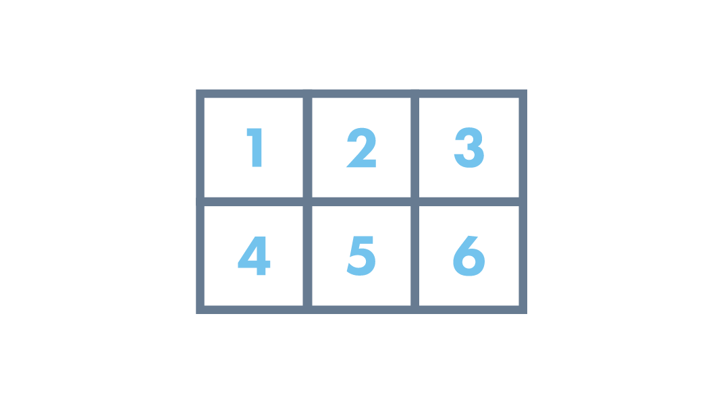
Today’s Topics
Menti
Timeline of Events
Submitting Your Campaign
The Showcase
The Circular Economy
Top Tips
Notes:
KH Notes:
What is marketing?
Types of Marketing
The success and fails
Marketing plans
The Importance of branding
Setting the story – engaging the customer

Slide 5
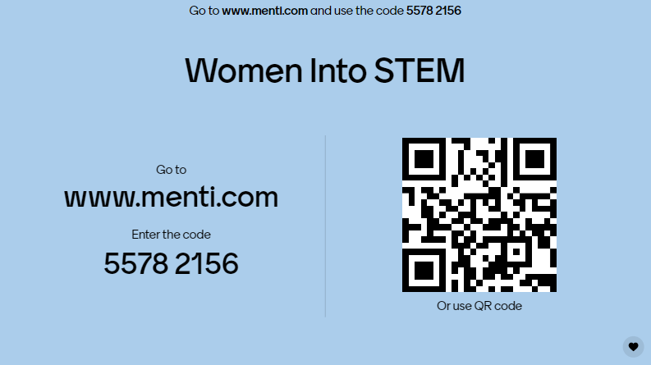

Slide 6




Timeline
Drop-in Session 8th March 12.30pm – 1.30pm (Teams)
Submission Deadline 18th March 5.00pm
Submission Review 23rd March
Showcase 30th March 12:30pm – 1.30pm (Teams)

Slide 7


Submitting Your Campaign
Submit your marketing campaign via Dropbox by clicking on this link – this will be shared with you!
https://www.dropbox.com/request/Euvme0kPFn3oF5ehDcxP
You should be able to upload most types of files here.
If you have any issues contact me Morven.McColl@yes.org.uk

Slide 8
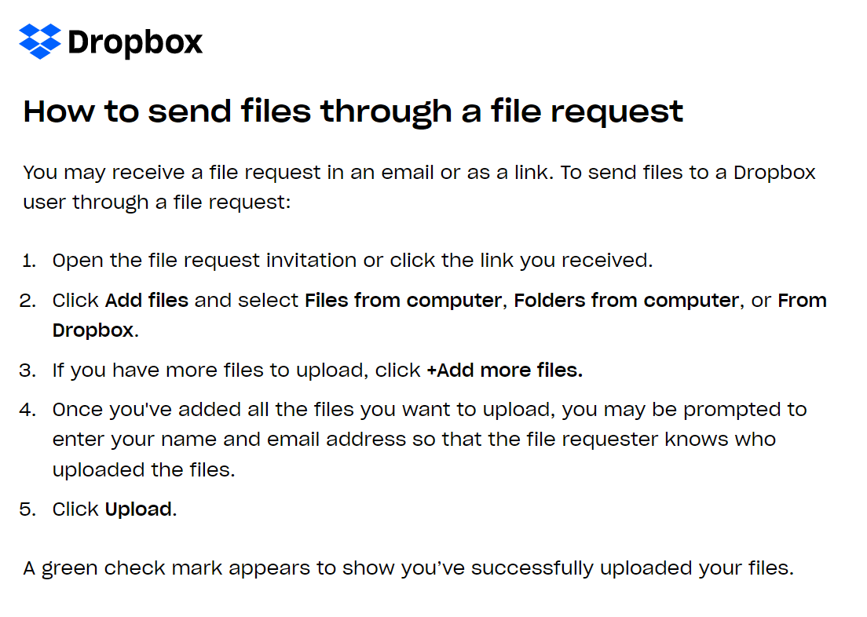

Slide 9
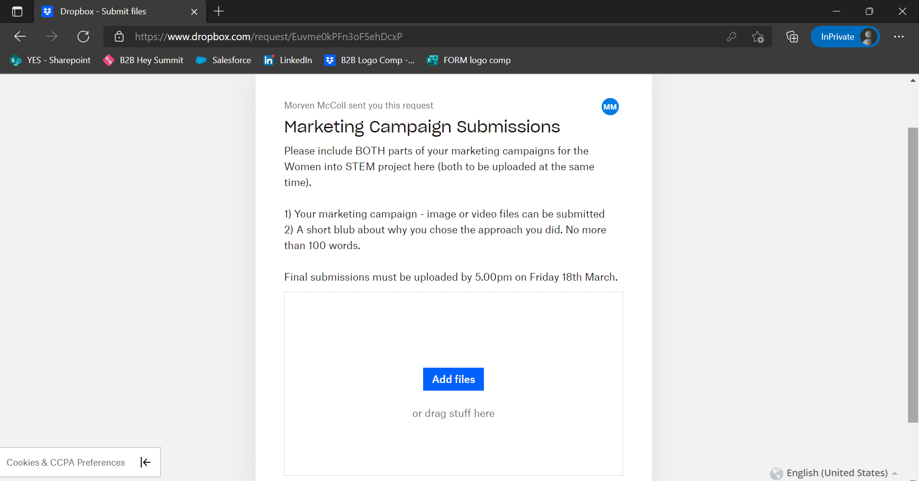

Slide 10


The Showcase Event
A celebration of all your hard work
Stakeholders and employers
Possible special recognition
Skills Development Scotland spotlight
Present your ideas

Slide 11


Where everything has value, and nothing is wasted.
Notes:
MM The following slides will take you through the key aspects of the challenge.

Slide 12
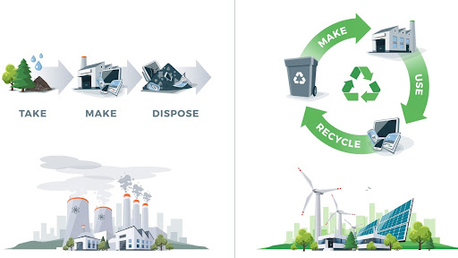
Linear Economy
Circular Economy
Cradle to Grave
Cradle to Cradle
Finite Sources
Renewable Sources

Slide 13
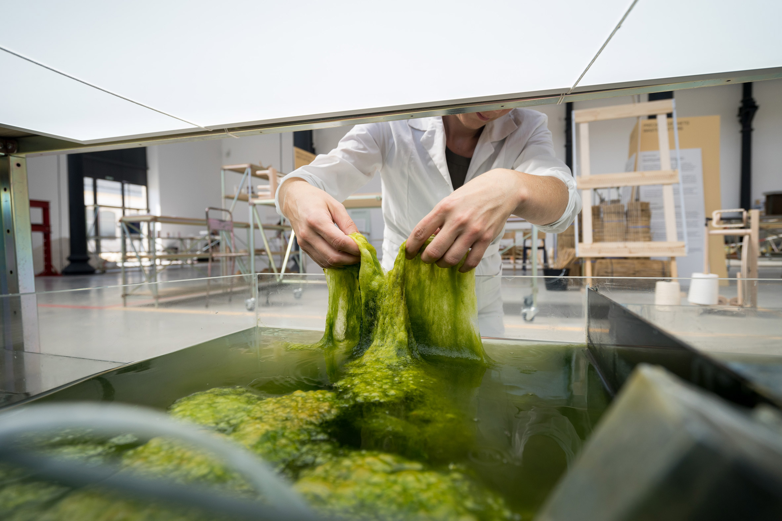

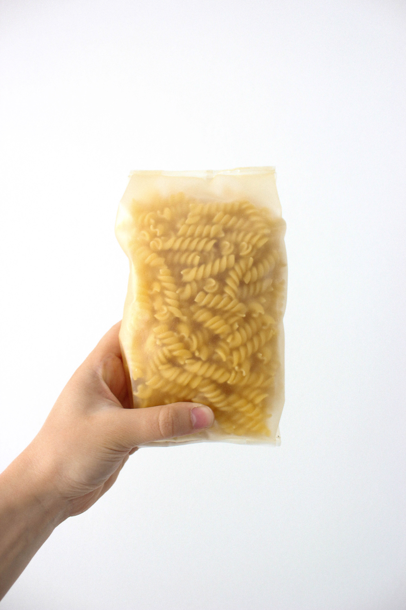
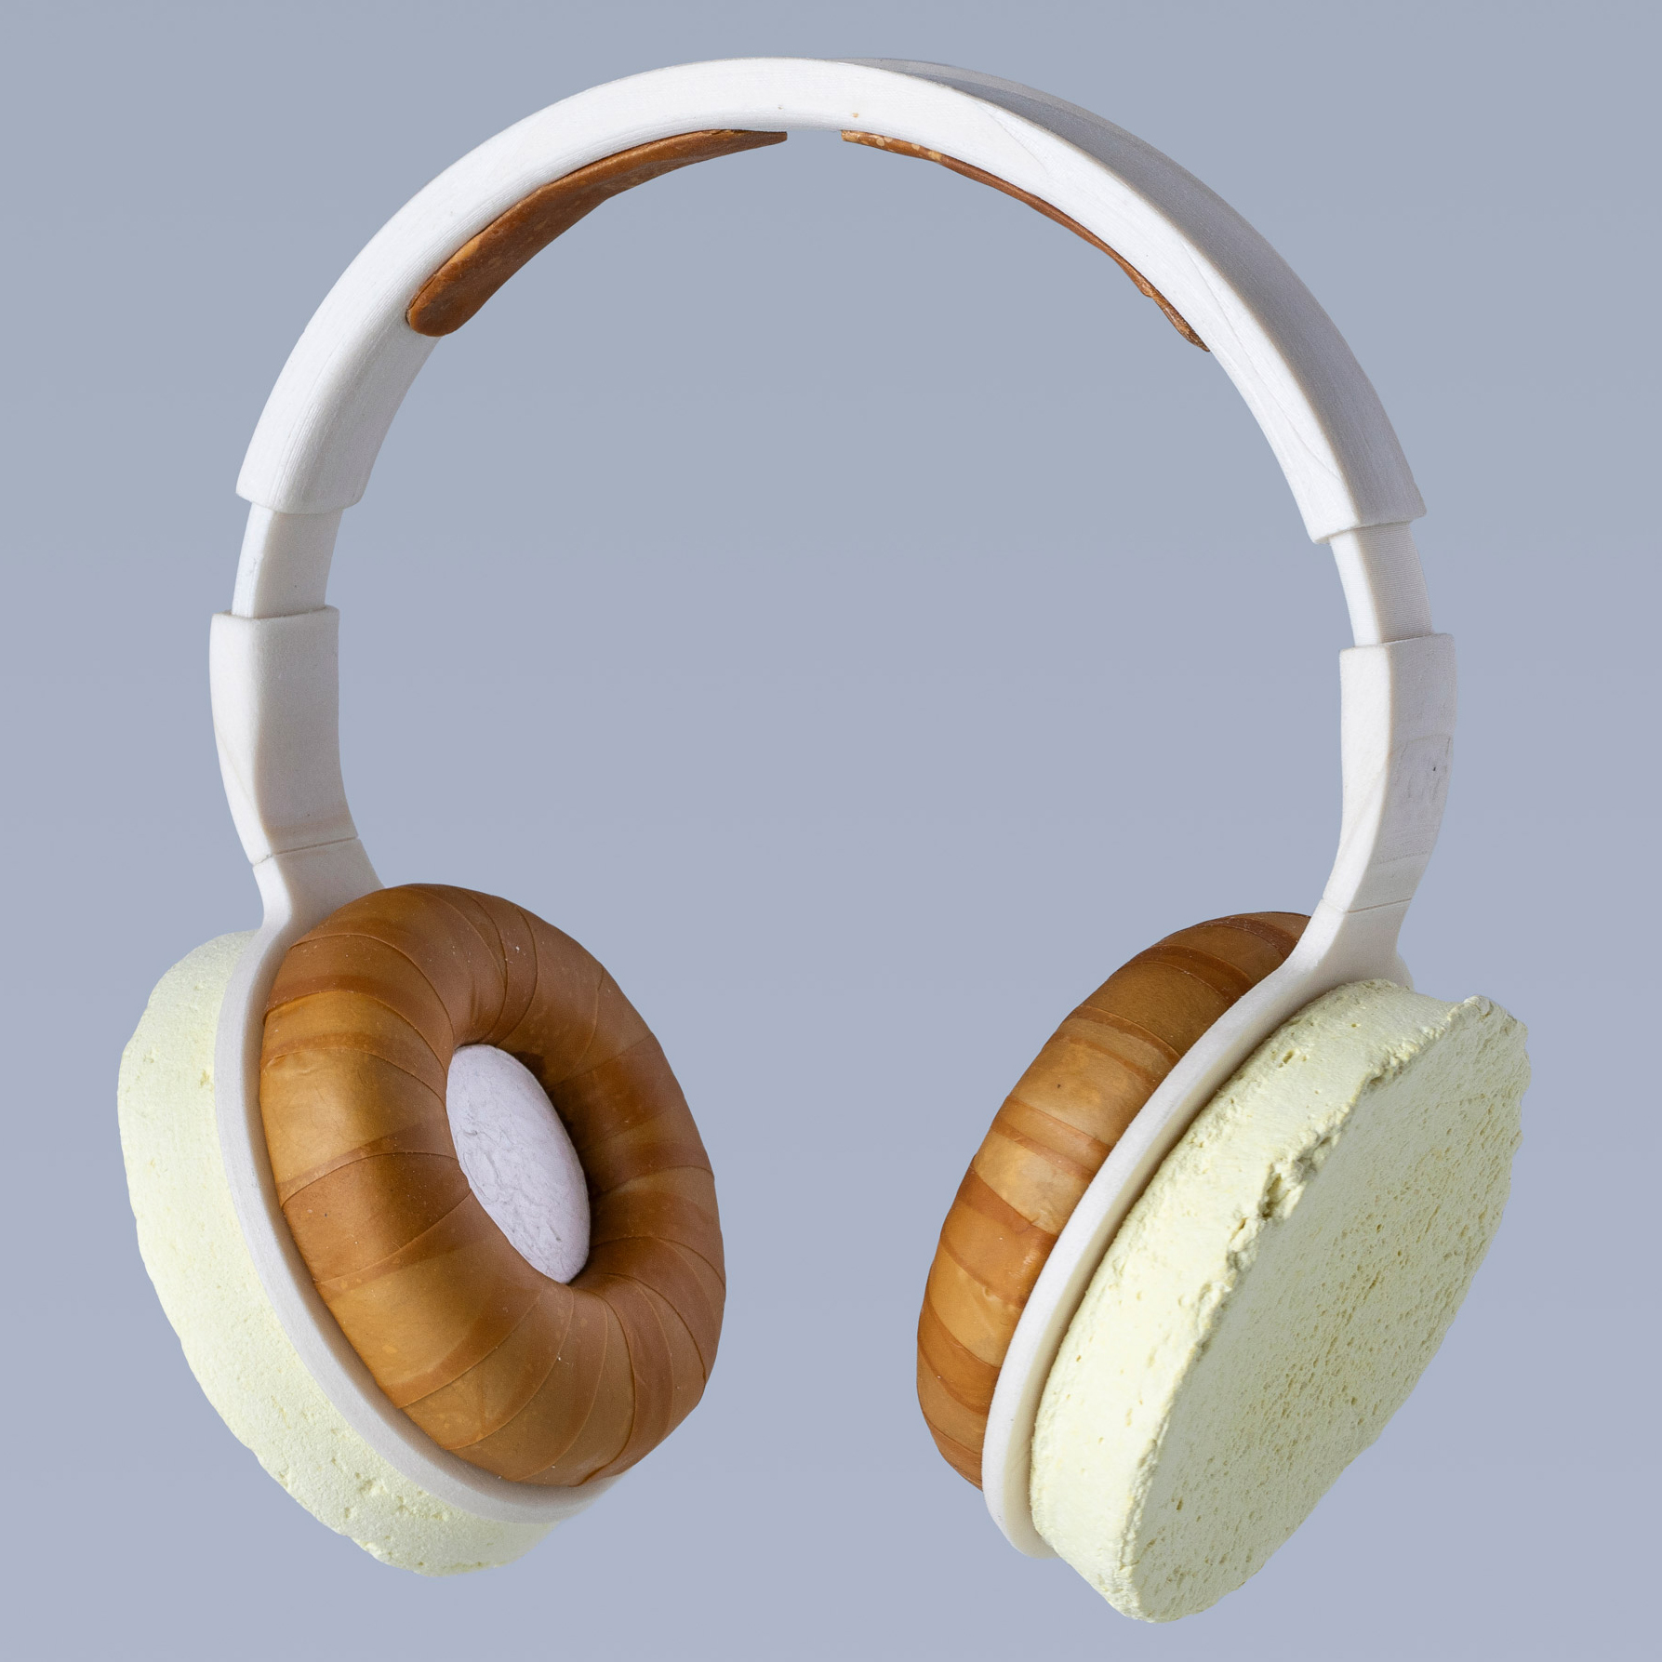

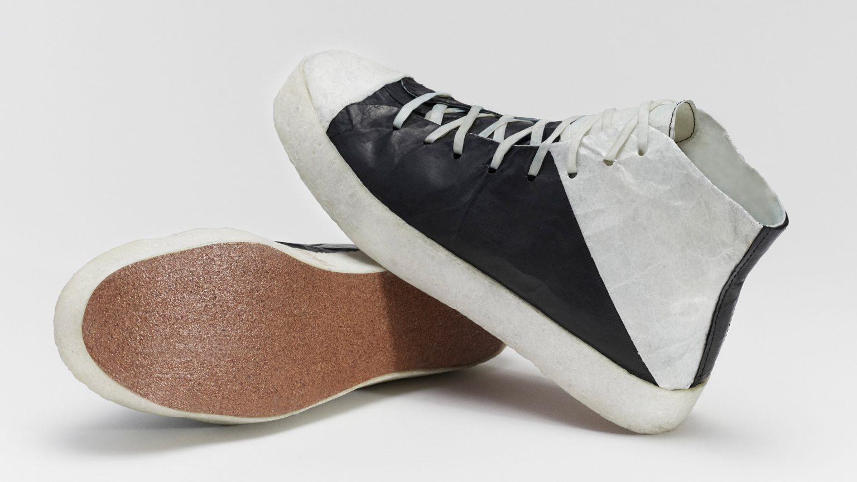

Notes:
MM Having a circular design is the best way to ensure there is never waste
Using nature Clockwise from top left:
Photos 1 and 2: Chile-based designer Margarita Talep has created a sustainable, biodegradable alternative to single-use packaging, using raw material extracted from algae
Photo 3: Dutch designers Eric Klarenbeek and Maartje Dros have developed a bioplastic also made from algae, which they believe could completely replace synthetic plastics over time. The designers believe that the algae polymer could be used to make everything from shampoo bottles to tableware or rubbish bins, eventually entirely replacing plastics made from fossil fuels like oil.
Photo 4: Hermes bag made from mycelium – the root system of mushrooms. There are many examples of mycelium products, from lamps to chairs to whole building structures! See lesson plans for BBC video on further examples.
Photo 5: trainers made from Kombucha waste. Kombucha is a sweet, fizzy drink made from bacteria, yeast, sugar, and tea. Fermented products like bread, wine, beer and Kombucha leave a waste mix of bacteria and yeast which can then be ‘grown’ and shaped. The trainers can last for years. When they are at the end of their life, they can be thrown in the compost heap and will break down in a couple of months.
Photo 6: headphones made from a variety of fungi, petrol-free bioplastic from baker’s yeast and cellulose from plants
Apps are a good example – there are no physical products, cutting down on resources and distribution by vehicles. (There are energy issues around 'server farms' however, and artists, musicians and writers are not always well paid by these sites...Could be worth some discussion on ethical business!)

Slide 14

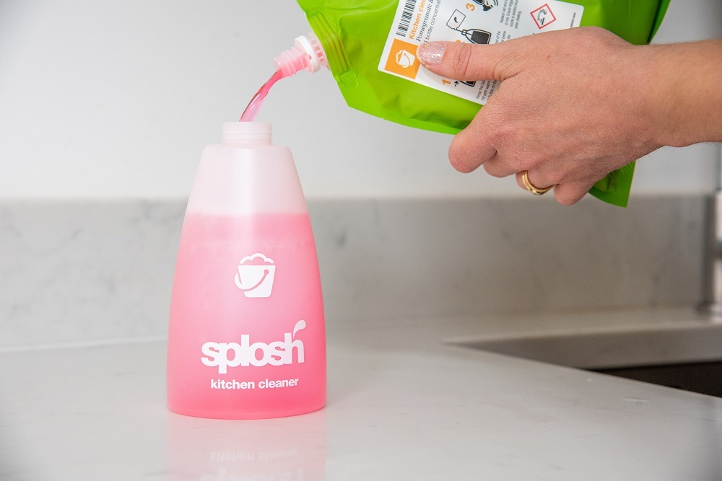
Circular Design Strategies
Smart Material Choice
Considering a product’s end of life treatment in the choice of materials and inputs. I.e., Durable, biodegradable, recycled or recyclable materials.
Example:
Customers of Splosh subscribe to receive pouches of concentrated cleaning products which either safely dissolve as part of the product or can be sent back for refill.
Notes:
(BD) SMART material choice – SMART seems to be the buzzword of the past few years and it’s use really is endless!
The idea here is that you don’t have waste at the end which needs to be recycled (As recycling itself is also a waste producing activity!) Instead, products are packaged in natural or bio-degrabable packaging. This can then be put on a compost heap or like washing machine liquid-tabs, might naturally dissolve naturally during it’s use.

Slide 15
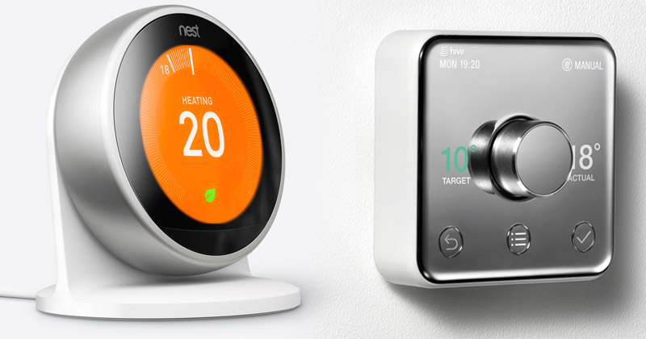
Circular Design Strategies
Embedding Intelligence
Building technology into materials or products to gather user data and generate valuable insights to improve the customer's experience.
Example:
Hive and Nest Active Heating devices use technology to learn user habits and save on cost and emissions. This in turn means less energy is needed and reduces demand on raw materials.
Notes:
(BD) Embedding Intelligence is a big movement at the moment in the development of SMART systems and SMART homes.
Hive and Nest Active Heating Devices are becoming very common in homes and can learn user habits in order to save costs and reduce emissions.
The focus here is less on ‘making a product which can be made again’ and more on reducing our overall carbon footprint and effects on the environment.

Slide 16
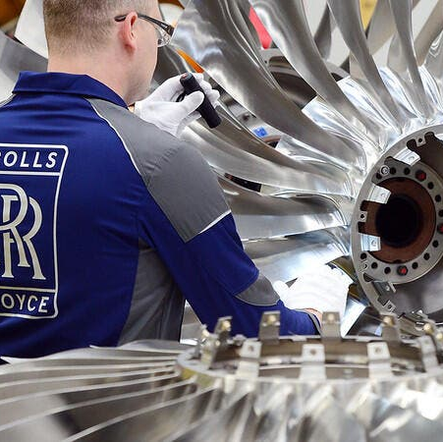
Rolls Royce Circular Business Model
Engines are leased to airlines (BA, Emirates, etc.) Engine maintenance remains with Rolls Royce meaning minimal pollution, frequent servicing, engine repairs decrease by 25%. RR engines have a longer service life than before. 95% of parts are now recovered or recycled.
Notes:
MM

Slide 17


Top Tips
Know your audience
Type of marketing
Marketing method(s) and style
Hook your audience
- by using facts or stories!
What is your ask of your audience?
80% delivery 20% content!

Slide 18





Get In Touch:
Morven McColl
Programme Executive – Bridge 2 Business
Morven.McColl@yes.org.uk
Morven McColl (@morven_mccoll) / Twitter
Morven McColl | LinkedIn
Notes:
Bridge 2 Business Student Support Feeling inspired and want to have a chat with Bridge 2 Business? Why not get in touch and schedule a 1-2-1 with us! In your 1-2-1 we’ll discuss your idea(s) or any of the initititaives you are interested in, and what support or funding could be best suited for you, as well as what other support is available to test your ideas, and get them off the ground. Some support from other external partners have age and industry restrictions – this is something we will discuss at your 1-2-1. We can help you develop your business ideas further through basic business planning to help you kick started!

Slide 19


Slide 20

Any Questions?

